Slide 1
AI-DRIVEN ELECTRONIC HEALTH TECHNOLOGIES IN CANCER MANAGEMENT: OPPORTUNITIES WITHIN AFRICA’S EMERGING GIG ECONOMY (NORTH CENTRAL NIGERIA)
BY
GRACE OJO-EMMANUEL (PhD)
AT
NACETEM SEMINAR SERIES MAY, 2026

Slide 2
PRESENTATION OUTLINE
INTRODUCTION
LITERATURE REVIEW
METHODOLOGY
RESULTS AND DISCUSSION
CONCLUSION AND RECOMMENDATION

Slide 3
Background to the Study
Cancer is a leading cause of death worldwide, accounting for nearly one in six deaths (World Health Organization, 2026).
For instance, there were an estimated 20 million new cancer cases and 9.7 million deaths in 2022 (WHO, 2026).
Africa countries, Nigeria inclusive have been largely affected by this health issue due to late-stage diagnosis and ineffective healthcare systems (Gichoya et al., 2025).

Slide 4
Background to the Study Cont’d
The study was conducted in North Central Nigeria, a region with inadequate financial funds toward health services, and poor health and digital literacy rates among the population (Olutoki et al., 2025).
The current health crisis is occurring against a backdrop of a fast-paced technological and economic transformation on the continent (Grancia, 2025).

Slide 5
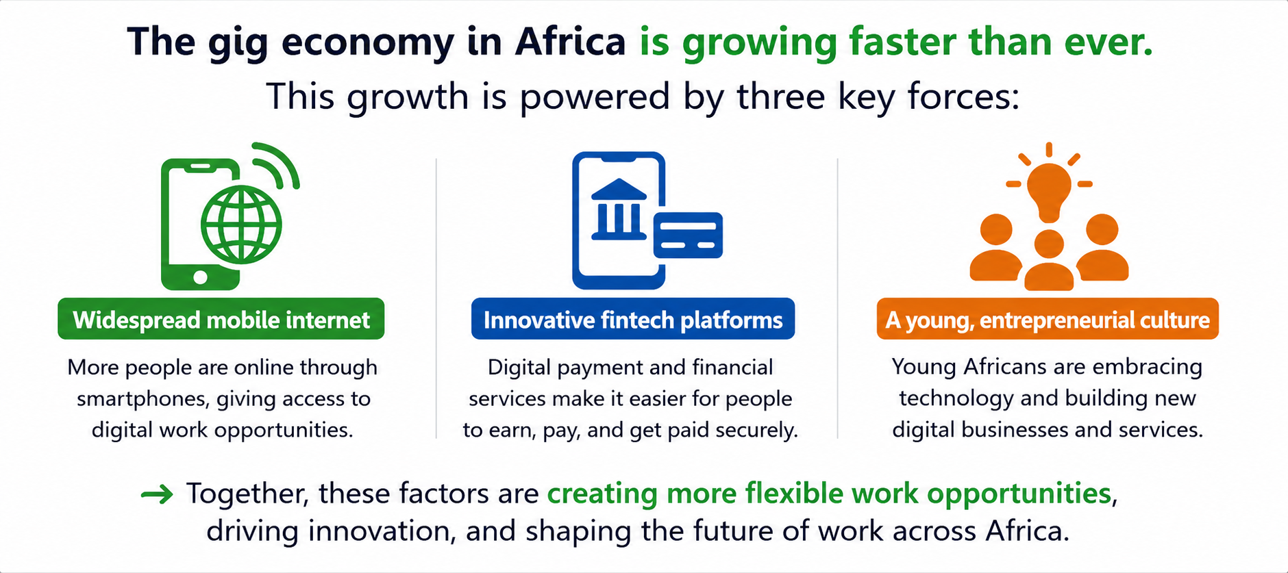
Background to the Study Cont’d

Slide 6
Background to the Study Cont’d
Healthcare logistics, telehealth, data annotation and remote clinical services are key areas where many gig workers in Africa, particularly in Nigeria, contribute to healthcare (Elechi et al., 2026).
AI-driven EHTs has the potential in improving the healthcare system resource management, mainly in cancer management (Nadeem, et al., 2025).
AI-driven EHTs enhance the accuracy of cancer detection, treatment, and clinical decision-making at an early stage (Momoh et al., 2024; Olawade et al., 2025).

Slide 7
Statement of the Problem
Despite AI-driven EHTs offer potential benefits, their adoption in healthcare for cancer treatment is not well known (Pande et al., 2025).
Few studies have been conducted about the impact of AI-driven EHTs in the North Central zone of Nigeria on gig economy (Achebo, 2025).

Slide 8
Research Questions
What are the AI-driven EHTs in use for cancer management within North Central Nigeria emerging gig economy? and
What are the impacts of these technologies on the gig economy in the study area?

Slide 9
Research Objectives
The specific objectives are to:
examine the AI-driven EHTs in use for cancer management within North Central Nigeria emerging gig economy; and
evaluate the impacts of these technologies on the gig economy in the study area.

Slide 10
LITERATURE REVIEW
Conceptual Review
AI-driven electronic health technologies (EHTs): A digital platforms and systems that leverage artificial intelligence to support various stages of cancer management (Wah and Jack, 2025).
Dimensions of Adoption in Cancer Management: Diagnostics and screening. precision treatment, and remote monitoring and virtual consultations (Donkor et al., 2023).
Intersection with the Gig Economy: The gig economy is based on flexible digital work, is progressively connected to AI-driven EHTs for cancer care via telehealth, data, and remote services (Jain and Joies, 2025; Wang et al., 2025).

Slide 11
LITERATURE REVIEW CONT’D
Applicable Theory:
Unified Theory of Acceptance and Use of Technology (UTAUT) (Venkatesh et al., 2003)
Diffusion of Innovations (DOI) Theory (Rogers,1995)
Empirical Review:
Eric (2019) examined the integration of artificial intelligence in healthcare, particularly in oncology.

Slide 12
LITERATURE REVIEW CONT’D
Empirical Review Cont’d
Keesara Srivats et al. (2020) investigated the expansion of digital health technologies and found that tools such as telemedicine and mobile health platforms significantly improve access to healthcare services and continuity of care.
Wood Alex et al. (2019) examined digital labour platforms and found that technological advancements foster flexible, platform-based, and contract-driven work arrangements.
Keesara Srivats et al. (2020) investigated the expansion of digital health technologies and found that tools such as telemedicine and mobile health platforms significantly improve access to healthcare services and continuity of care.

Slide 13
METHODOLOGY
UTAUT (Individual-Level Factors)
Performance expectancy
Effort expectancy
Social influence
Facilitating conditions
Conceptual Framework
Adoption and Application of AI-Driven EHTs
Cancer Management Outcome
Early detection
Treatment efficiency
Clinical decision-making
Gig Economy Opportunities
Digital health jobs
Remote diagnosis
Telemedicine services
Job flexibility
Diffusion of Innovation System (Individual-Level Factors)
Relative advantage
Compatibility
Complexity
Trialability
Observability
Moderates and Influences Adoption and Use
Figure 2.1: Conceptual Framework of AI-Driven EHTs for Cancer Management

Slide 14
METHODOLOGY CONT’D
Descriptive research design: Cross-sectional
Study Area: 3 selected states in the North Central Zone: Kogi, Kwara, and Niger also Federal Capital Territory (FCT) Abuja
Population and Sampling: Multistage- Staff and Patients
Research Instrument: Questionnaire (Expert reviews and pilot test)
Method of Data Analysis: descriptive and inferential statistics

Slide 15
METHODOLOGY CONT’D
Table 2: Variables and Measurement
Objective | Variable | Item | Measurement | Source
1 | AI-driven Technologies | Whether adopting or not | Yes or No | Kabukye et al. (2022) and Slater et al. (2016)
2 | Gig Economy Opportunities | Whether AI-driven EHTs have impacts on Gig Economy or not | Yes or No | Alanezi and Alanzi, 2020

Slide 16
RESULTS AND DISCUSSION
Table 3: Socio-Demographic Characteristics of Respondents
Characteristics |  | Frequency (%) | Characteristics | Frequency (%)
 |  | Staff |  | Patients
Gender | Male | 63 (52.5) | Female | 70 (58.3)
 | Female | 57 (47.5) | Male | 50 (41.7)
 | Total | 120 (100) |  | 120 (100)
Age | 30-50 years | 54 (45.0) | >55 years | 52 (43.3)
 | < 30 years | 42 (35.0) | 30-50 years | 49 (40.8)
 | >55 years | 24 (20.0) | < 30 years | 19 (15.8)
 | Total | 120 (100) | Total | 120 (100)
Qualifications | BSc/HND | 59 (49.2) | BSc/HND | 66 (55.0)
 | Lower than BSc/HND | 22 (18.3) | Lower than BSc/HND | 29 (24.2)
 | Postgraduate Qualifications | 16 (13.3) | Postgraduate Qualifications | 9 (7.5)
 | Professional Certification | 14 (11.7) | Professional Certification | 9(7.5)
 | Others | 9 (7.5) | Others | 7 (5.8)
 | Total | 120 (100) | Total | 120 (100)
Computer Knowledge | Intermediate | 73 (60.8) | Intermediate | 65 (54.2)
 | Advanced | 26 (21.7) | Advanced Novice | 28 (23.3) 27 (22.5)
 | Novice | 21 (17.5)
 | Total | 120(100) | Total | 120(100)
Job Experience | 10 -15 years | 34 (28.3) | - | -
 | 6 - 9 years | 27 (22.5) | - | -
 | 0 - 5 years | 21 (17.5) | - | -
 | 16 - 25 years | 20 (16.7) | - | -
 | Above 25 years | 18 (15.0) | - | -
 | Total | 120 (100) | - | -

Slide 19
CONCLUSION
The study concluded that the adoption of AI-driven EHTs are advancing. Yet, adoption of advanced technologies like robotic surgery remains minimal.
The study further revealed that AI-driven EHTs are efficient tools to optimize cancer management and have statistically significant benefit which gives room for development and growth of the gig economy.

Slide 20
RECOMMENDATION
Federal, state, and institutional stakeholders should priorities robust, scalable digital infrastructure to fully integrate AI-driven EHTs, including high-speed internet, and secure data servers.
Continuous professional development programmes should be implemented to improve the digital literacy and operational competence of healthcare workers.
Policymakers for instance National Cancer Control Programme (NCCP) and National Institute for Cancer Research and Treatment (NICRAT) should support the scaling up of advanced digital tools such as robotic surgery, and artificial intelligence, while also considering the underserved and rural areas.

Slide 21
RECOMMENDATION CONT’D
Policymakers are advised to integrate gig economy participants, such as community health agents and platform-based service workers, into cancer care service models, using their access to opportunities and technologies to make AI-based eHealth services accessible to underserved and rural communities.
Strategic collaboration between government, private health providers, technology firms, and development partners should be fostered to mobilise resources, share expertise, and ensure sustainable implementation.

Slide 22
THANK YOU FOR YOUR ATTENTION

